Slide 1
Threats and opportunities to human development in the Global South from a technological perspective
For discussion about UNDP HDR on 7 Dec. 2021
Michel Zhou
Deputy Director-General
Finance Center for South-South Cooperation Hong Kong

Slide 2

Main topics：
1. Rising global inequality
2. Overall threats
3. Waves of digital technology changes
4. Threats of technology
5. Opportunities of technology

Slide 3
1. Rising global inequality
A huge gap between the rich and the poor in the current society and among countries.
Rising global wealth inequality−as the richest 1% people owns 88% world's wealth. Income inequality highest.
During COVID-19, millions of people, students in DCs could not continue education or jobs due to lack of access to internet and ICT devices.
Low skilled and educated labour in DCs may be easily excluded from the labor market and entering the increasingly technologically advanced business world.
DCs’ lack of scale, data and technology which are foundation of AI deep learning, enterprises in DCs lagging further behind or disadvantaged in digital transformation.
The poor and vulnerable people’s lack of access to digital infrastructure and opportunities, LDCs worse, lagging far behind.

Slide 4
2. Overall threats
Economic threats of inflation, fiscal crises, surging debts, asset bubbles;
Societal threats such as social instability, involuntary migration, disparity concerns with ethnicity, races and marginalized people;
Food crises and hunger, water crises, infectious diseases and poverty;
Labour force disruption-Unemployment and informal work. Low-medium skilled labour needs hollowing out by automation;
More digitalized, informal, and temporary labour while work welfare lagging; Working poor and widening inequality.
Other threats may result from climate change, esp. biodiversity loss related to agriculture, livelihoods and natural resources.

Slide 5

3. Three waves of digital technology changes of the 4IR
First wave: computer, broadband, mobile telecommunications
Second wave: internet platforms, social networking, cloud computing (such as application in ecommerce, distance education)
Third wave: Internet of things, robotics, machine learning and AI, big data/analytics, 3D printing

Slide 6
3.1. Widening technology divide
The internet penetration rate :
-- 96% in Northern Europe as of Jan. 2021. 99% vs 0% in some countries.
-- 81% in developed countries, 41% in developing countries. 17.5% in least developing countries as of 2017.
40% population has no access to internet while global average internet penetration rate reached 59.5% as of Jan. 2021.
Developing countries are in a very passive position in the distribution of dividends in the global digital economy. Not digital consumer or producer country due to various limits.
Technology-driven wealth growth concentrates in developed economies

Slide 7
4. Threats of new technology:
Workforce disruption, widening digital divide, mental health, inequality, cyber insecurity issues:
Concerns of losing job due to 2/3 jobs automation and work digitalization. 1.2 billion workers to be automated, and job stress, esp. women workers in service and low-skilled sectors; Influence worker’s mental health, esp. women.
Lack of social security or welfare due to remote and temporary work, and informal labour as digital labour platforms rise.
Degradation of human relationships. Barriers facing young generations to develop independently, interpersonal skills, reading and living alone. Mental health issues emerge.
Pushes the society to move along a “capital intensive pathways to wealth generation”, may create poverty traps and cause inequality rise.

Slide 8

4.1.Threats of new technology (continued):
Social networking by isolating individuals and widening social distance. esp. gender divide, female lagging behind.
Deepens social inequalities between the haves and the have-nots in education, business operation, etc. Therefore disparities in labour quality, wealth accumulation and development rise.
Cyber insecurity from cyberattacks, data fraud or theft, violation of privacy, and current lack of global technology governance.

Slide 9
5. Opportunities of technology innovation
- To eliminate poverty, including digital poverty
Improve human life with higher efficiency, better health and skills. New jobs in services and information sectors.
Boost new economy, talent training, digital infrastructure, ecommerce. Join hands to narrow the digital gap and catch up with the technology development in the South.
Move towards digital inclusion through wider and closer cooperation, in education, ecommerce, manufacturing, agribusiness, indirect employment via social networks.
Sharing of experience, knowledge and technology through peer learning, nationally and internationally. Accelerate education in digital technologies.
Promote technology transfer and application for more integrated cross-sector and cross-country development, global supply and consumption.
Attracts more funds for technology transfer, training and integration to share more technological dividends.

Slide 10
5.1. Opportunities of technology innovation(continued）
Meaningful multilateral and multi-sectoral cooperation to tackle technological risks from AI, cyberattacks, etc. Data sharing, verification, and usage.
Jointly design shared protocols for AI and other new technology; Formulate national, regional and international technology governance framework and standards.
Restructure trade, labour and supply chain via new technology application, and optimize matching of technology, labour and resources within a nation and cross-country.
Improved tools and methods to tackle emission for Net Zero economy and improve public services (health care, education, e-government), agriculture, manufacturing through remote digital technologies and application.

Slide 11
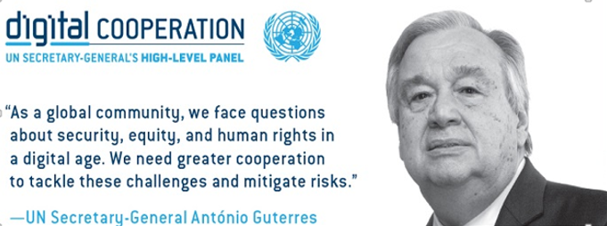
Thank you very much
Meixiang (Michelle) Zhou
Email: michel.zhou@fc-ssc.org

